Slide 1
Movie ticket booking system
Presented By:
Priyanka Ghimire
Manisha Sharma
Diptan gurung

Slide 2
Introduction
Movie ticket booking system is a system design to simplify the process of reserving movie tickets.
It provides a comprehensive solution for movie enthusiasts to book their tickets with ease.

Slide 3
Problem statement
Complex payment integration
Poor user interface and user experience

Slide 4
Objectives
To improve user experience and accessibility
To make a seamless payment integration

Slide 5
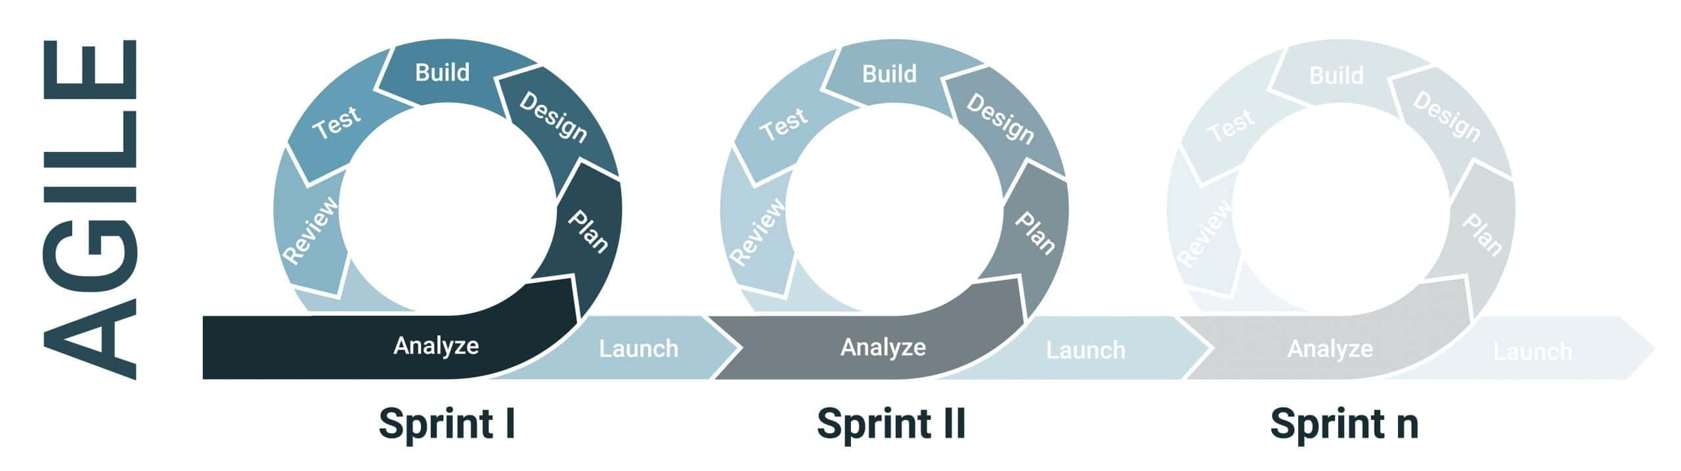
Methodology

Slide 6
Functional requirement
User Registration and Login
Browse Movies and ShowTime's
View seat availability
Book tickets
Payment processing
Edit/ Cancel Booking
Admin management

Slide 7
Non-Functional requirement
Security
Usability
Reliability

Slide 8
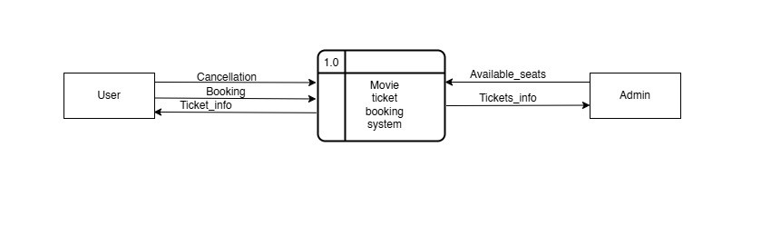
Data flow diagram
Level-0-DFD

Slide 9
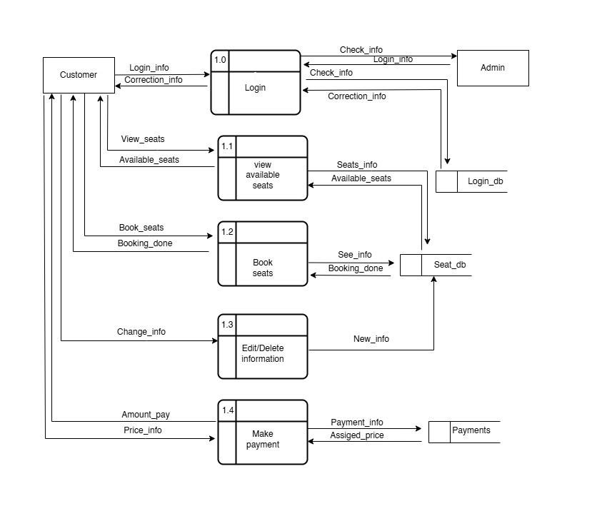
Level-1-DFD

Slide 10
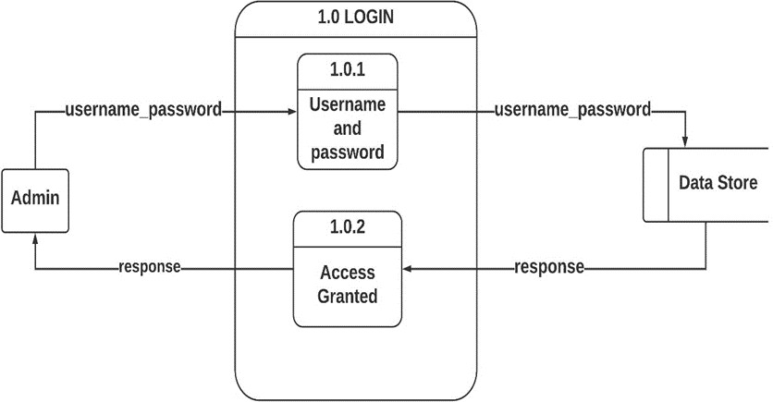
Level-2-DFD (admin Login)

Slide 11
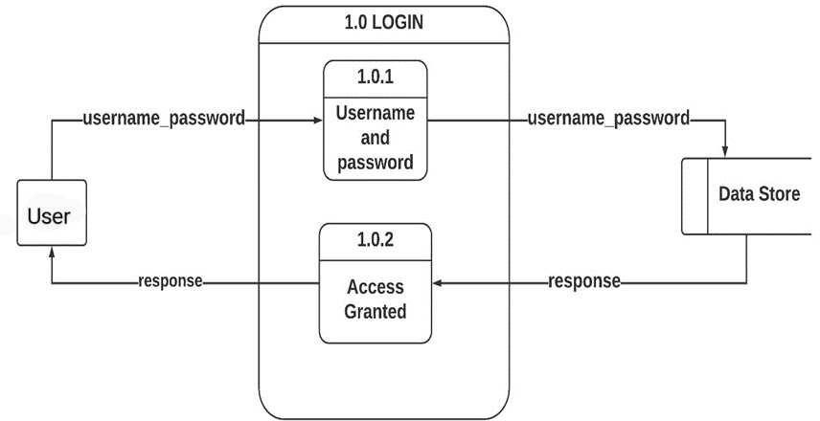
Level-2-DFD (user Login)

Slide 12
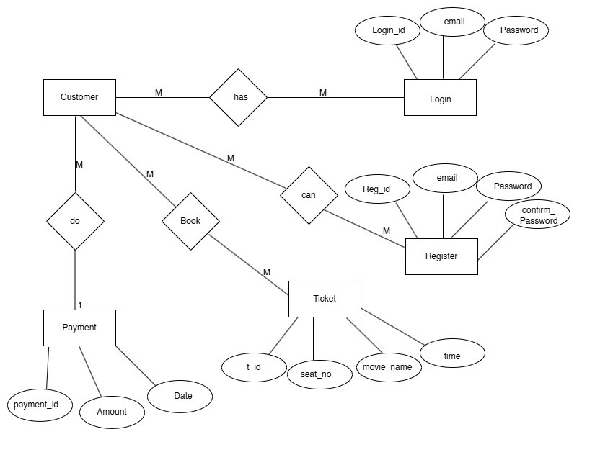
Er-diagram

Slide 13
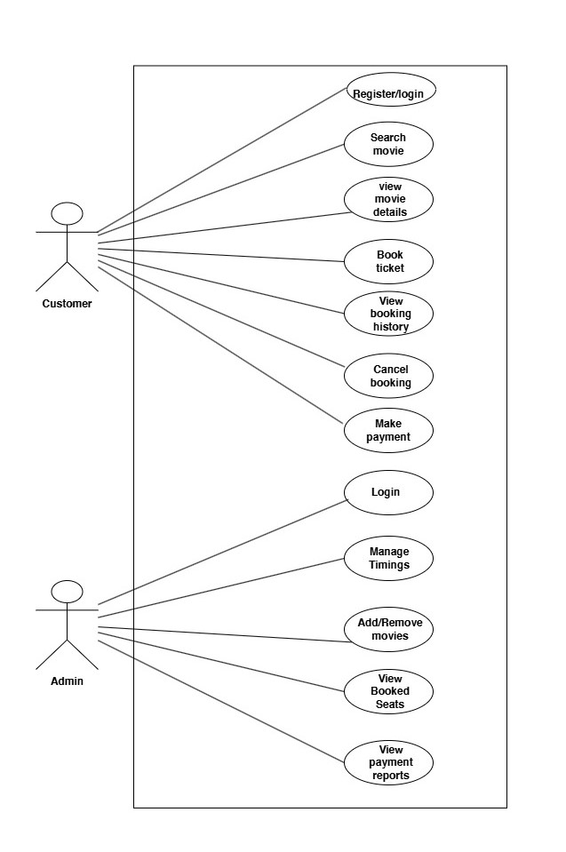
Use case diagram

Slide 14
Task completed
Frontend:
Login and Registration Pages:
Designed and implemented using HTML, CSS, and JavaScript.
Booking Page Design:
Designed interface for users to select movie, date, time, and seats.
Backend:
Login and Registration Functionality:
Developed using PHP.
Integrated with the MySQL database for user authentication and registration.

Slide 15
Needs to be done
Backend Implementation:
Database Connection for Booking System:
Establish connection between the booking form and the MySQL database.
Implement data storage for user-selected movie, date, time, and seats.
Payment Gateway Integration:
Add payment functionality to enable secure online payments.
Integrate with popular payment APIs.
Admin Features:
Implement admin functionalities to add, delete, and edit movie details in the system.
Create an admin dashboard for easier management.

Slide 16
Thank you!!

